Slide 1

Week 2!!!
Learning Unit 2 – Graphical Summaries
Your Plotting Professor Colton

Slide 2
LU 2 Outline
Introduction
Why Summaries and Plots?
Frequency Tables
Frequency Tables
Frequency Table Graphs
Histograms
Relative Frequency Histograms
Other Visual Tools
Stem and Leaf Plots
Dot Plots
Time Series Plots
Measures of Shape

Slide 3
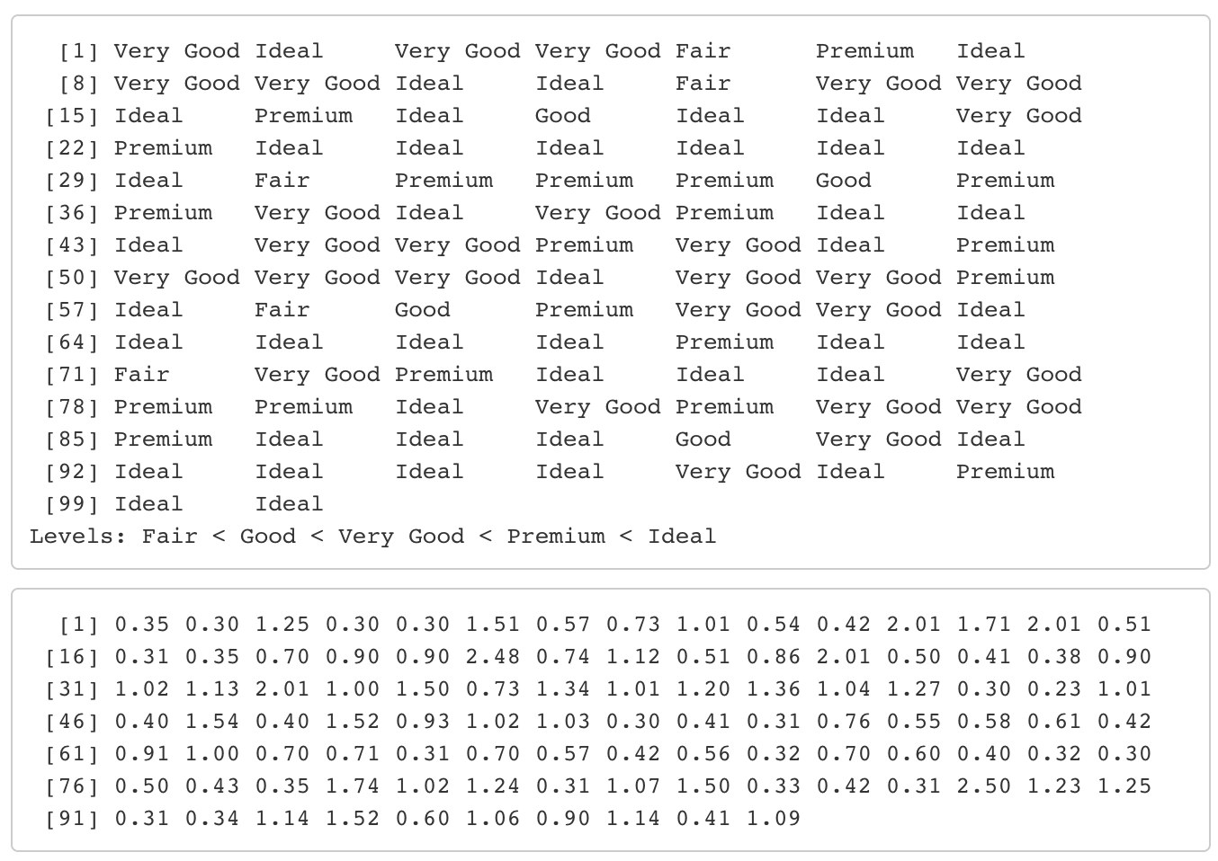
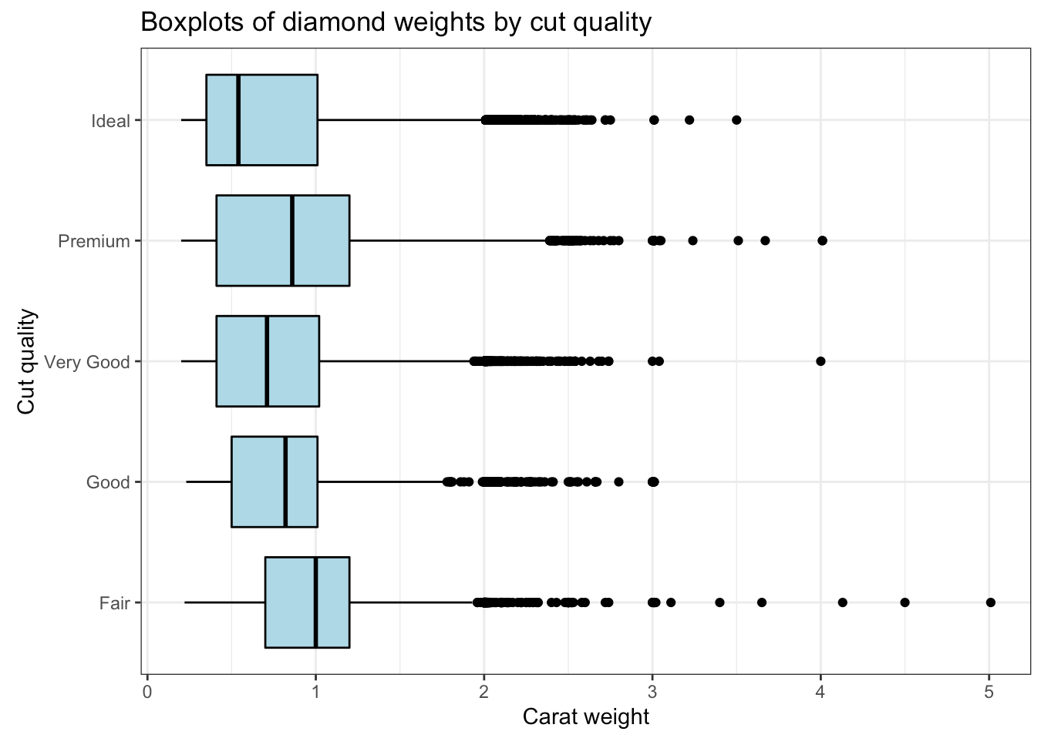
Introduction – Why Summaries and Plots?
Terrible idea to display raw information! Way too much!
Two parts of any data analysis: Understanding and Relating!!

Slide 4
Review + New
What type of visual we can make depends on what type of data we have.
Qualitative (Categorical) Data
Non-Numerical data with different categories.
Ex) States, letter grades, class standing, etc.
Quantitative Data
Numerical data, counts or measurements
Arithmetic operations such as adding and averaging make sense
Ex) Income, GPA, Height, Weight, etc.
In creating graphs, it is important to first consider the distribution of a variable.
The distribution of a variable is a list of what values the variable can take on as well as how often it takes on these values.
Often, the distribution of quantitative variables is summarized in a table like the following example.

Slide 5
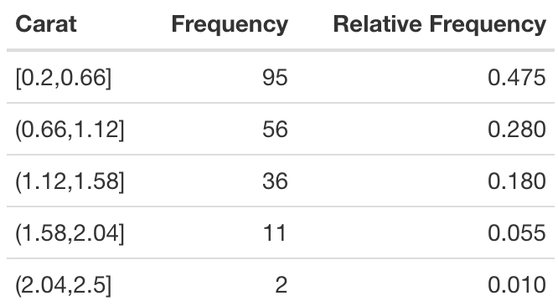
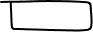
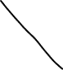
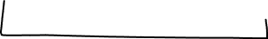
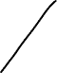
Frequency Tables for Numeric Data
Frequency Tables
Used to organize both quantitative and qualitative data sets.
They also are helpful in some generating graphs we will discuss later!
How to Construct for Numeric Data
Data is binned, i.e. grouped together. All bins (aka classes) will have equal length.
This length is referred to as the bin / class width = upper limit – lower limit
Then we count the number of observations in each bin.
This count is referred to as the Frequency.
Can also find the Relative Frequency, which is just the proportion (or percent) of data in each bin.
This is just the Frequency divided by the Total.
Total: 200 1.00
* This can be referred to as grouped data now

Slide 6
LCQ: Frequency Tables
Data (20 observations):
38, 33, 5, 5, 47, 29, 24, 42, 3, 18, 30, 46, 25, 44, 40, 42, 39, 44, 29, 13
Construct a Frequency Table
Bin | Frequency | Relative Frequency
0-10
10-20
20-30
30-40
40-50
Total:

Slide 7
LCQ: Frequency Tables
Data (20 observations):
38, 33, 5, 5, 47, 29, 24, 42, 3, 18, 30, 46, 25, 44, 40, 42, 39, 44, 29, 13
Construct a Frequency Table
Bin | Frequency | Relative Frequency
0-10 | 3 | 3/20 = 0.15
10-20 | 2 | 2/20 = 0.1
20-30 | 4 | 0.20
30-40 | 4 | 0.20
40-50 | 7 | 0.35
Total: | 20 | 1.00
20 ≤ x < 30
30 ≤ x < 40
Check work:
3 + 2 + 4 + 4 + 7 ==== Total 20
15% + 10% + 20% + 20% + 35% ==== 100%

Slide 8
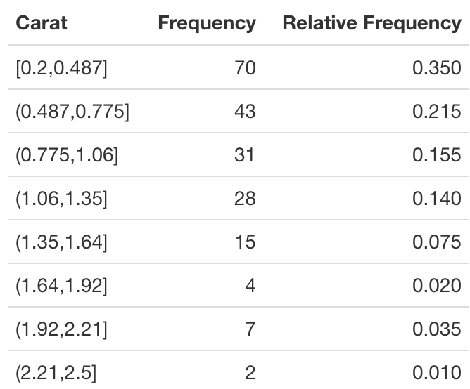
Frequency Tables
Choosing the Bins
Subjective choice
Depends on how granular (closely, exactly) you want to show the data.
With more bins, each bin gets smaller (smaller class width).
So the data gets more spread out across the bins (smaller frequencies and relative frequencies).

Slide 9
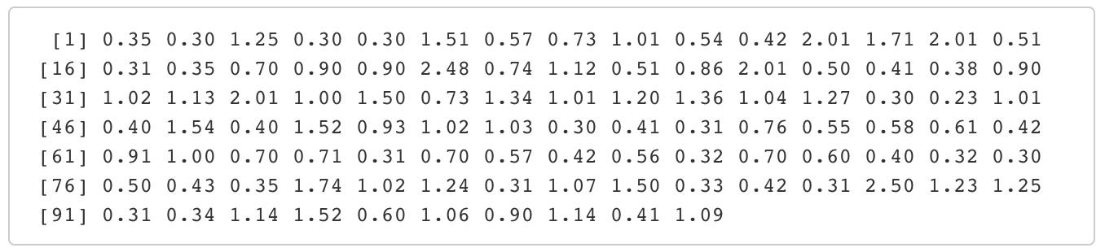
Frequency Tables
Advantage of Using Frequency Tables
Great for condensing and summarizing the raw data.
Disadvantage of Using Frequency Tables
We lose information.
We no longer know what the specific values were, only what bin (range of values) they are in.
So why not just use a lot of bins????
Then we would be keeping more information right??

Slide 10
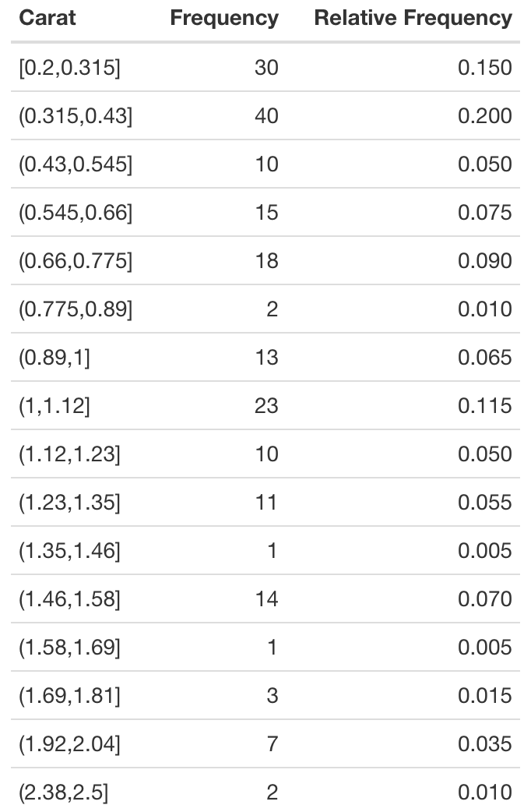
Frequency Tables
Balancing Act
Yes, using more bins keeps more info…
But then it loses the conciseness that made it a good representation in the first place.
Hard to really get anything from this frequency table…
So you have to be smart about choosing the number / width of the bins (classes)!
We will learn how to set the ranges for each bin next class!

Slide 11
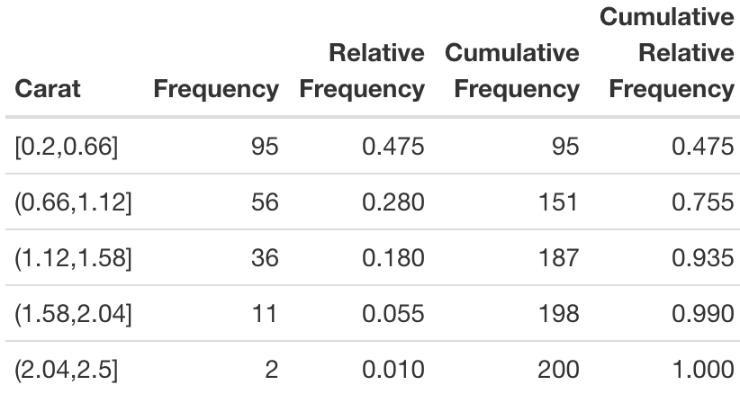
Cumulative Frequency
Cumulative Frequency
This is a running total of the frequencies
So for a class, it is the number of values less than or equal to that class.
Can also do this as cumulative relative frequency.
So just continually add the relative frequencies as you move down the classes

Slide 12
LCQ: Cumulative Frequency
Data (20 observations):
38, 33, 5, 5, 47, 29, 24, 42, 3, 18, 30, 46, 25, 44, 40, 42, 39, 44, 29, 13
Construct the rest of the earlier Frequency Table
Bin | Frequency | Relative Frequency | Cumulative Frequency | Cumulative Relative Frequency
0-10 | 3 | 0.15
10-20 | 2 | 0.1
20-30 | 4 | 0.20
30-40 | 4 | 0.20
40-50 | 7 | 0.35
Total: | 20 | 1

Slide 13
LCQ: Cumulative Frequency
Data (20 observations):
38, 33, 5, 5, 47, 29, 24, 42, 3, 18, 30, 46, 25, 44, 40, 42, 39, 44, 29, 13
Construct the rest of the earlier Frequency Table
Bin | Frequency | Relative Frequency | Cumulative Frequency | Cumulative Relative Frequency
0-10 | 3 | 0.15 | 3 | 3 / 20 = 0.15
10-20 | 2 | 0.1 | 3 + 2 = 5 | 5 / 20 = 0.25
20-30 | 4 | 0.20 | 5 + 4 = 9 | 0.45
30-40 | 4 | 0.20 | 13 | 0.65
40-50 | 7 | 0.35 | 20 | 1
Total: | 20 | 1

Slide 14
Frequency Table Graphs
Graphs (in general)
Use graphs to display data visually.
Important to know which type of data (qualitative or quantitative) each different type graph we discuss shows.
Frequency Table Graphs
Frequency tables help construct Histograms and Relative Frequency Histograms.
To create these in graphs by hand or in Excel, you first have to make a frequency table.

Slide 15
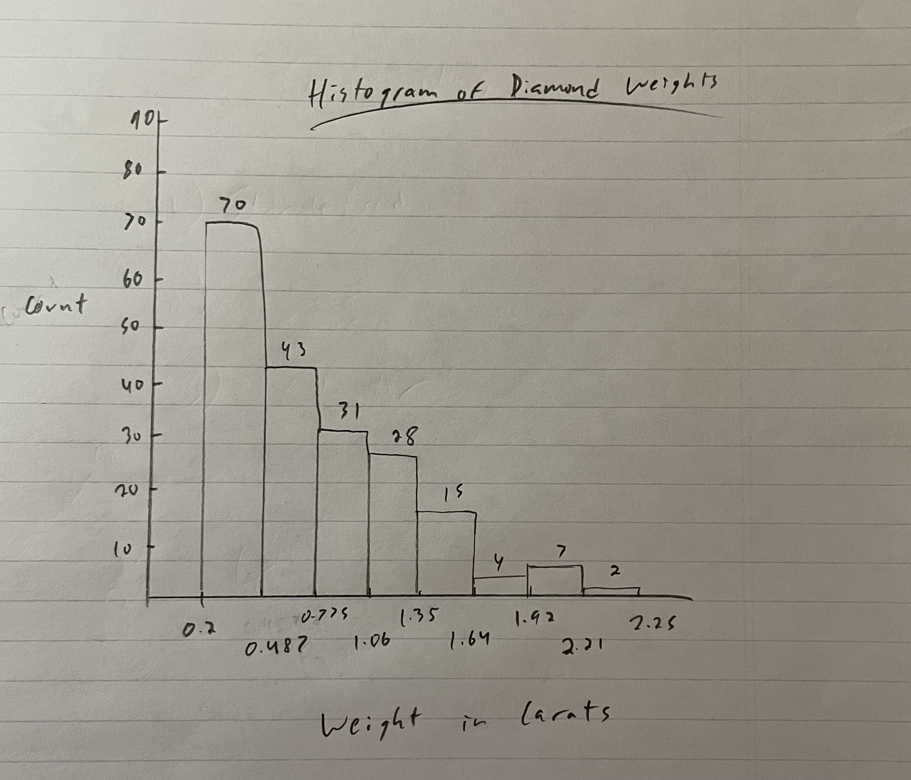
Histograms
Histograms
For Quantitative data.
Each bar represents a bin from the Freq table.
Features
Bars touch! This is because we have to account for every possible value along the x-axis.
Each bar is the same width.
This makes comparisons across bars valid!
Heights of each bar represents the Frequency for that bin.
Sum of all the heights equals the total sample size.
CAN’T tell the specific value of observations, only the interval its in.
This is why we lose information when grouping the data for Freq Tables / Histograms.
Advantages
Pretty simple.
Shows shape and mode (the most common value) well!

Slide 16
LCQ: Histograms
Bin | Frequency | Relative Frequency
0-10 | 3 | 3/20 = 0.15
10-20 | 2 | 2/20 = 0.1
20-30 | 4 | 0.2
30-40 | 4 | 0.2
40-50 | 7 | 0.35
Total: | 20 | 1
Data (20 observations):
38, 33, 5, 5, 47, 29, 24, 42, 3, 18, 30, 46, 25, 44, 40, 42, 39, 44, 29, 13
Sketch a Histogram
Questions we can ask:
Context: Lets say this data represents the scores for a football team.
What is the range of scores?
How many games had 30 or more points (score ≥ 30)?
What percentage of games had less than 20 points (score < 20)?

Slide 17
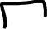
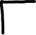


LCQ: Histograms
Bin | Frequency | Relative Frequency
0-10 | 3 | 3/20 = 0.15
10-20 | 2 | 2/20 = 0.1
20-30 | 4 | 0.2
30-40 | 4 | 0.2
40-50 | 7 | 0.35
Total: | 20 | 1
Data (20 observations):
38, 33, 5, 5, 47, 29, 24, 42, 3, 18, 30, 46, 25, 44, 40, 42, 39, 44, 29, 13
Sketch a Histogram
Questions we can ask:
Context: Lets say this data represents the scores for a football team.
What is the range of scores? Scores range from 0 to 50
How many games had 30 or more points (score ≥ 30)? 4 + 7 = 11
What percentage of games had less than 20 points (score < 20)?
0.1 + 0.15 = 0.25 or (3 + 2) / 20

Slide 18
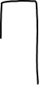
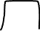
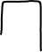
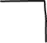
Histograms again
Histograms by Midpoints
Will also see classes defined by the Midpoints, rather than the lower and upper bounds
Midpoint = (Lower limit + Upper limit) / 2
This is how we will make histograms on the Lab in Excel
Can find the class width by subtracting consecutive midpoints!
Bin | Midpoint | Frequency | Relative Frequency
0-10 | (0 + 10) / 2 = 5 | 3 | 0.15
10-20 | (10+20) / 2 = 15 | 2 | 0.1
20-30 | 25 | 4 | 0.25
30-40 | 35 | 4 | 0.25
40-50 | 45 | 7 | 0.35
Total: |  | 20 | 1

Slide 19
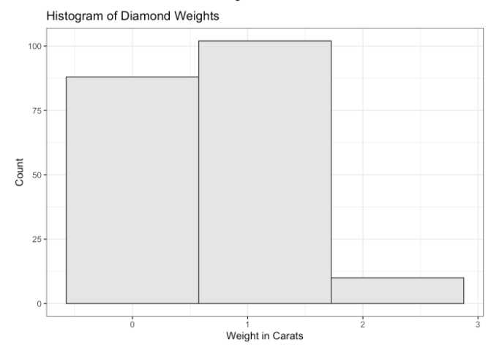
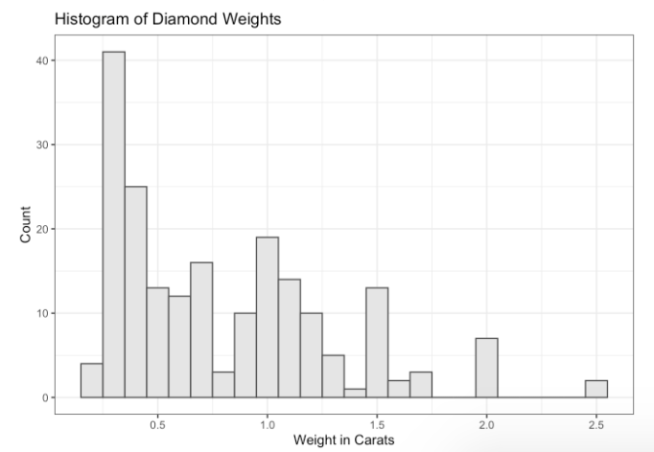
Histograms
Choosing the Bins
Again bin selection has a big impact on the final graph.
Don’t want too few bins, cause then you don’t really get any info…
More bins is better (to an extent).
Shows the data more closely, can see more individual spikes.

Slide 20
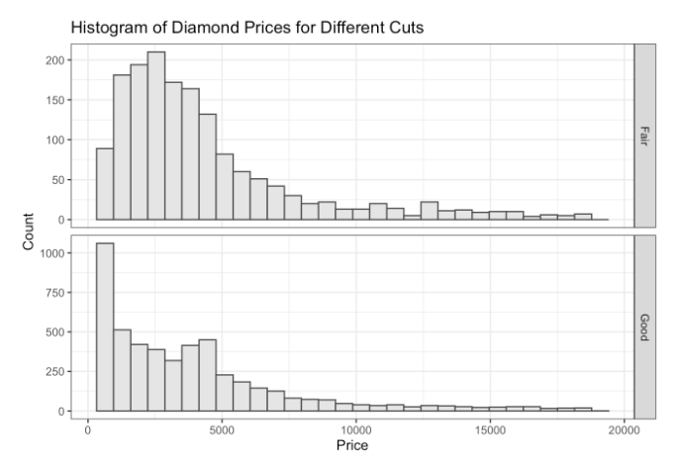
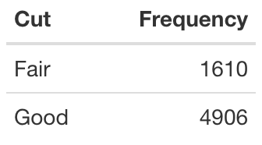
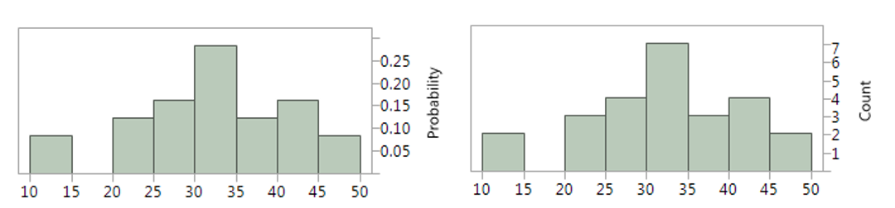
Relative Frequency Histogram
Advantage
Useful when comparing groups with DRASTICALLY DIFFERENT sample sizes.
Just using counts could be misleading….
Using proportions puts the bars on the same scale, making it a fair (visual) comparison
Relative Frequency Histogram
Same as a regular histogram, except now the Relative Frequencies (proportions, probabilities, %) are on the y-axis.
Sum of all the height equals 1.

Slide 21
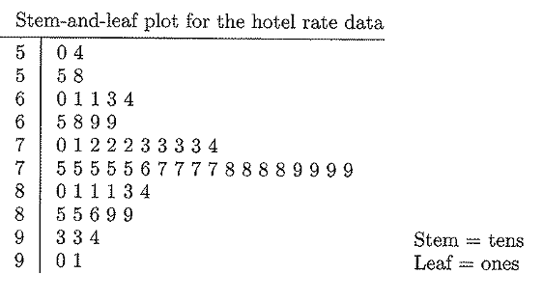
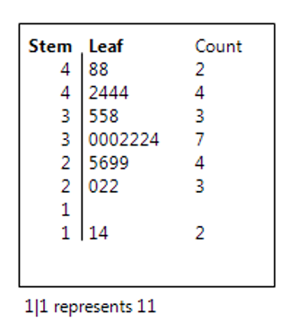
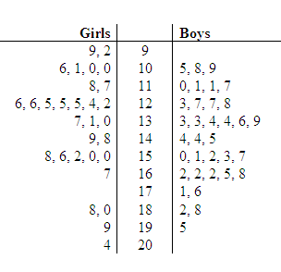
Stem and Leaf Plots
Stem and Leaf Plot
(Weird) way to display quantitative data.
Best for SMALL datasets.
Two-sided chart that separates data values by digits.
Displays the shape of the distribution and displays all data values.
Back-to-Back Stemplot
Used to compare two distributions
Data: 48, 48, 42, 44, 44, 44, 35, 35, 38, 30, 30, 30,…., 14
Stem (tens place)
Leaves (ones place)
https://www.ck12.org/statistics/two-sided-stem-and-leaf-plots/

Slide 22
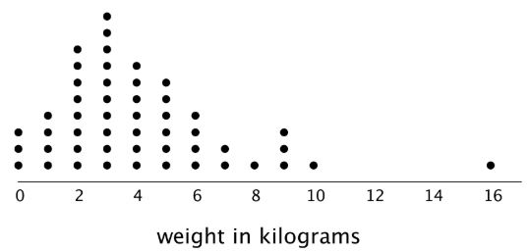
Dot Plots
Dot Plot
Quick and easy method for organizing quantitative data, dots on a number line.
Best for SMALL datasets.
Displays the shape of the distribution and displays all data values.
Can see “outliers”.
How to Construct
Just stack dots above the value…
https://math.libretexts.org/Bookshelves/Arithmetic_and_Basic_Math

Slide 23
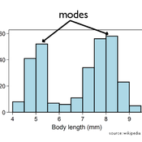
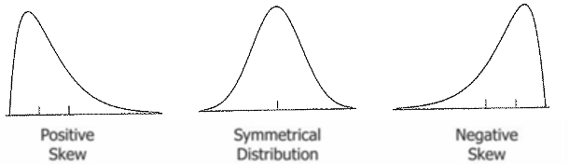
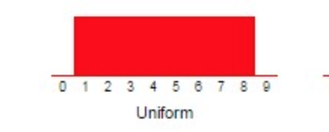
Measures of Shape
Define how the data is distributed.
Up to 2 things to report.
SHAPE: Is the data symmetric, right (positive) skewed, or left (negative) skewed?
MODALITY: Is the data unimodal, bimodal or multimodal?
Depending on the type of graph, this won’t always be known. If you can’t tell, don’t report.
Another shape
Uniform
Roughly same height across.
http://mathcenter.oxford.emory.edu/site/math117/shapeCenterAndSpread/

Slide 24
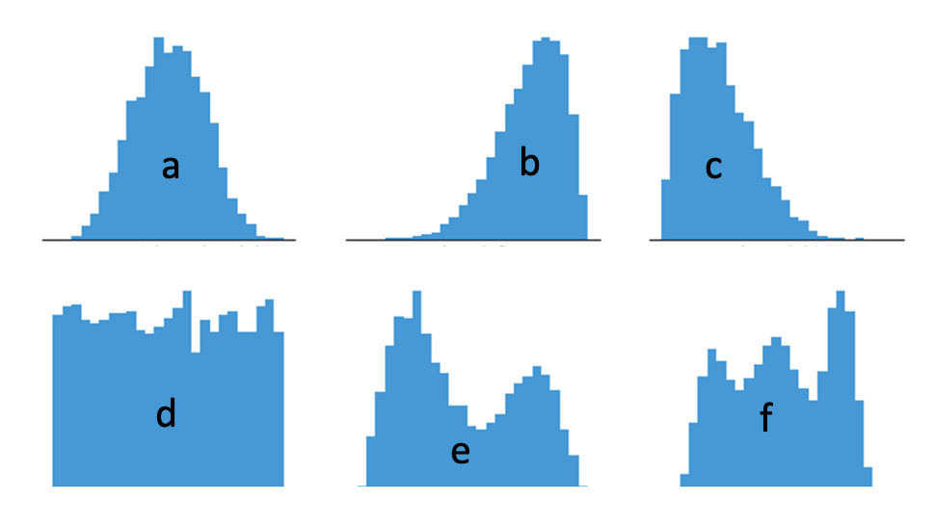
LCQ: Measures of Shape
Describe the SHAPE and MODALITY of each histogram
a)
b)
c)
d)
e)
f)
https://chartio.com/learn/charts/histogram-complete-guide/

Slide 25

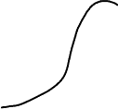
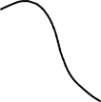
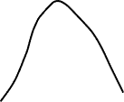
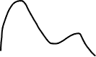
LCQ: Measures of Shape
Describe the SHAPE and MODALITY of each histogram
a) Symmetric and unimodal
b) Negative (left) skew and unimodal
c) Right skewed (positive) and unimodal
d) Roughly uniform (implies symmetric); can’t say anything about the modality
e) Not symmetric and bimodal
f) Non symmetric (maybe roughly symmetric) and multimodal
https://chartio.com/learn/charts/histogram-complete-guide/

Slide 26
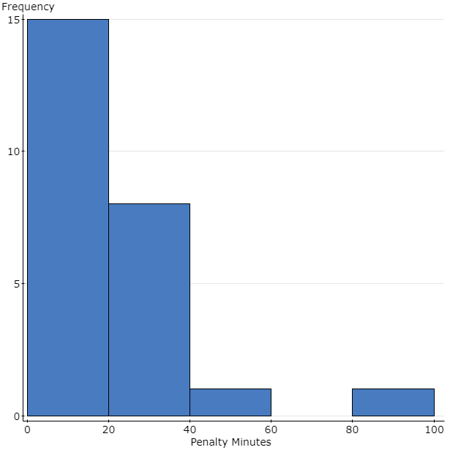
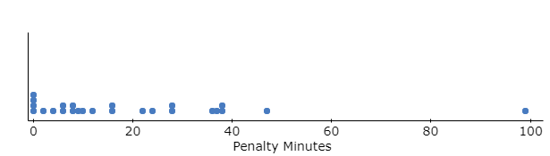
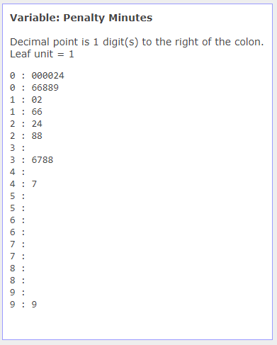
Overall Example
Setup: Penalty minutes per player during the 14-15 season for the Miami University RedHawks Ice Hockey Team are located in the table below as well as in the dataset “2014 RedHawk Hockey”.
Here are 3 different graphs to display the same info. Notice what information you can get (and what you can’t) from each display.
All display shape (right skewed) and modality (unimodal)
Histogram only shows mode as 0 – 20, whereas stemplot and dotplot show its really just 0 – 5 or 0 (most exact)
All show outliers, but with histogram we only know the range of the outlier (80 – 100), whereas stemplot and ~ dot plot shows us it is 99
Stemplot and ~ dotplot show all values
Notes:
Personal preference as each has benefits and drawbacks.
Boxplot lets you easily see if there are outliers and if it is skewed. What about the mode though?
Histograms let you see mode and skewness, but what if that outlier was smaller? Would it be as easy to tell?
Dotplot requires a little more “work” to see skewness if outliers are not present. But you get a good idea of where the data is located in terms of the values.

Slide 27
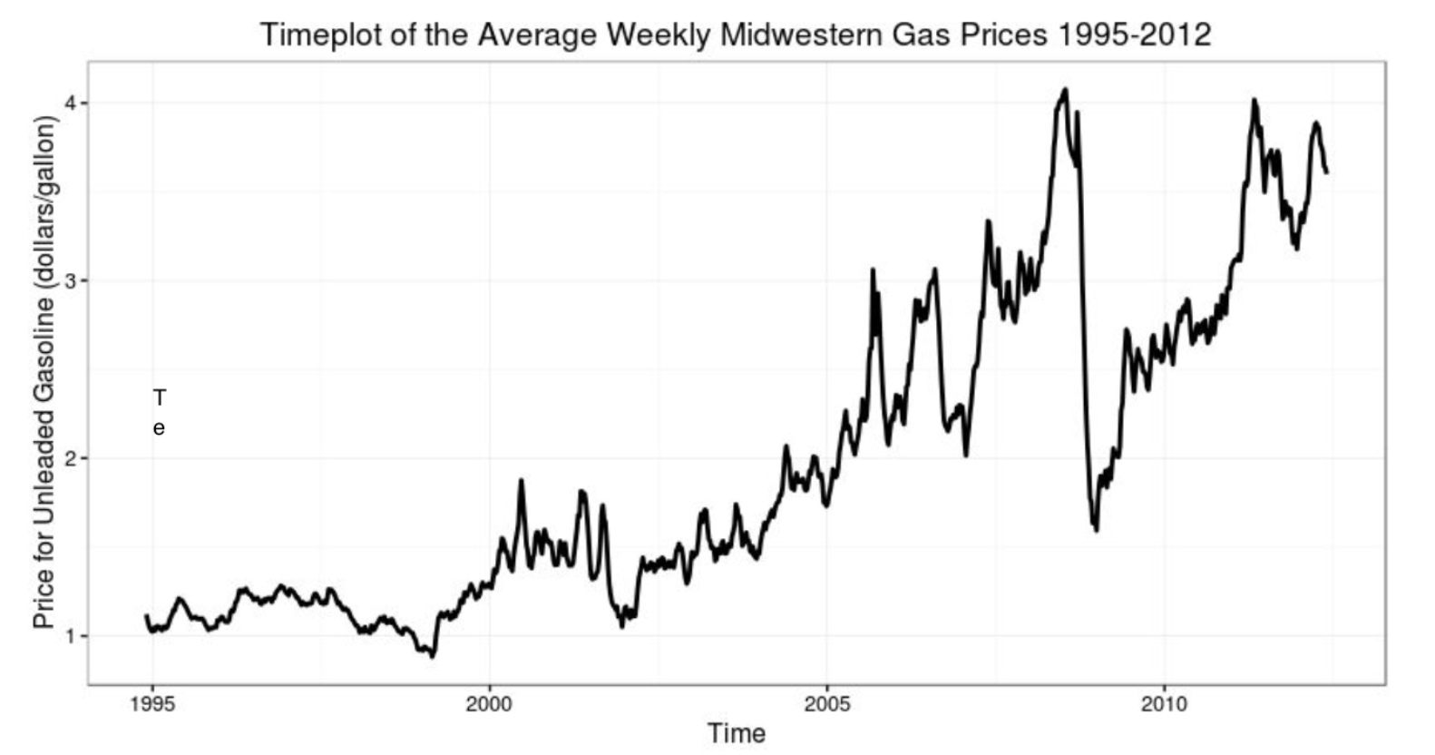
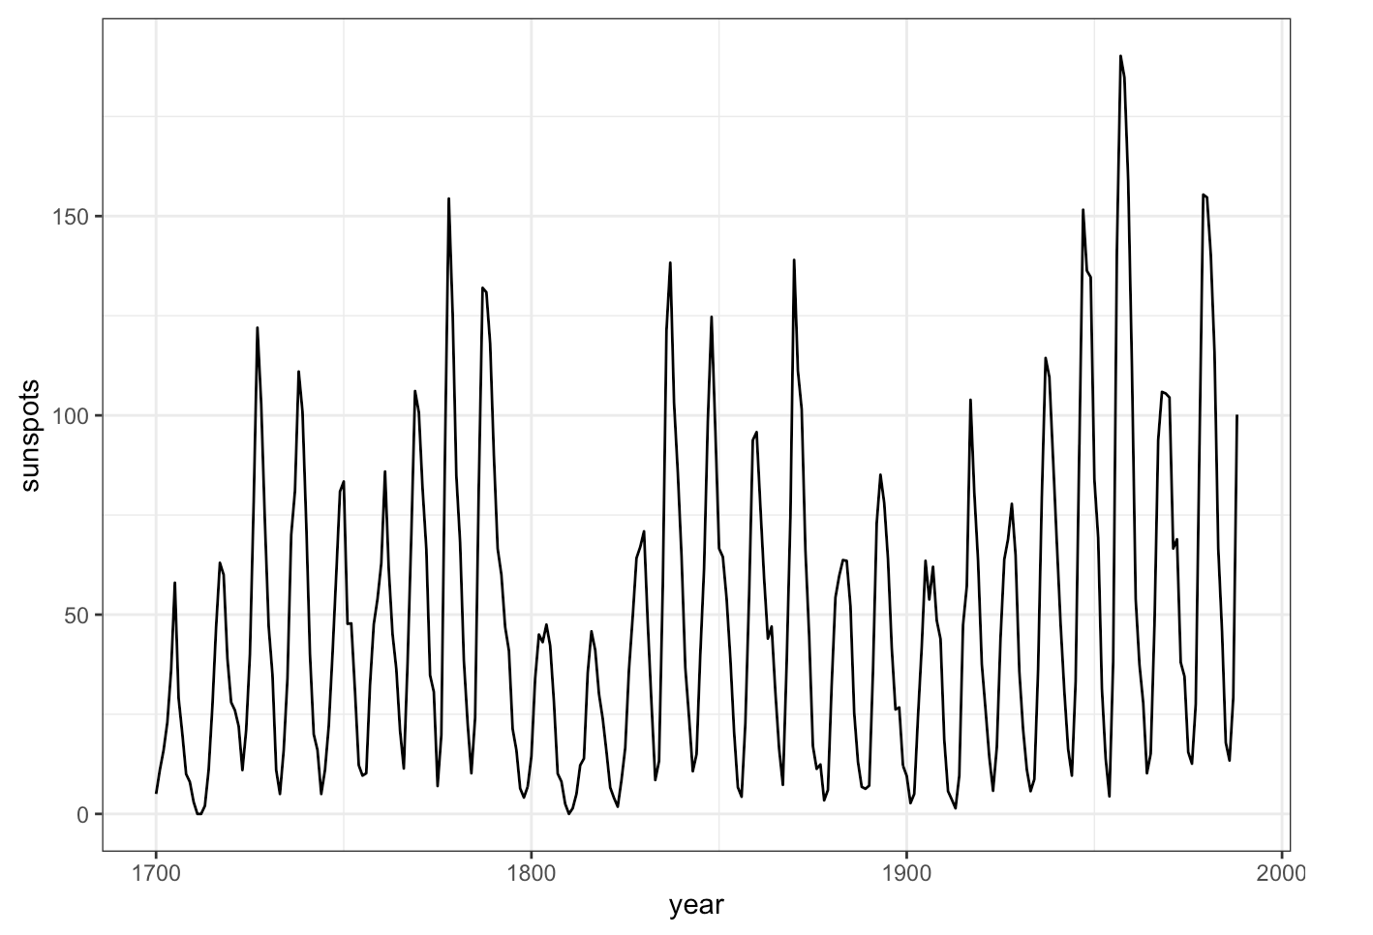
Time Series Plots
Time Series Plot
Displays changes in a quantitative variable over time (aka time series data).
Time values on x-axis and values on y-axis.
Time is measured over equally spaced increments, e.g. days, months, years, etc.
Best way to see trends (long-term upwards or downwards) over time!
Also shows seasonal variation (cyclical pattern)!
This can be interpreted as change over time that has a regular pattern that repeats.
Examples: Hourly temperatures, monthly gym enrollment
How to Construct
Line graph (connect the dots) with time values on x-axis and values on y-axis.
https://wwwbis.sidc.be/silso/datafiles

Slide 28
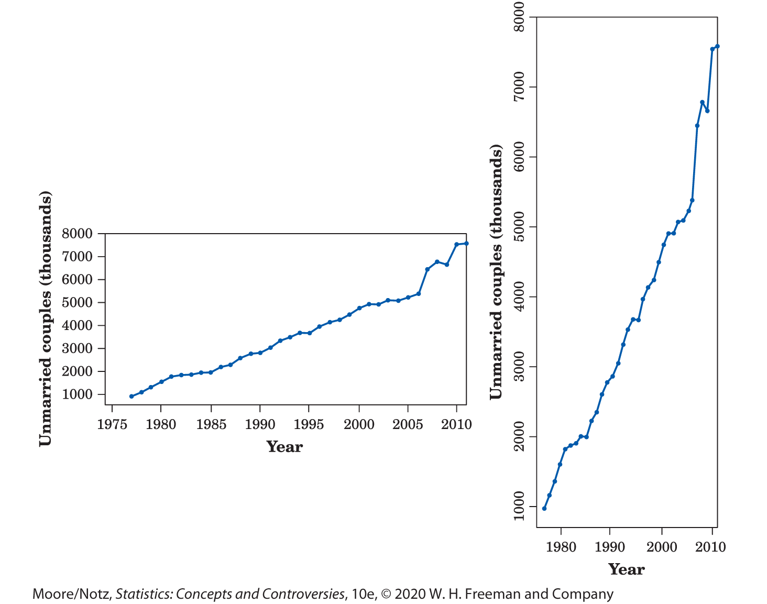
Scales of Time Series Plots
Scales of Time Series Plots
This is something that you need to pay attention to when interpreting a time series plot.
Very easy to manipulate axes to change the interpretation of a visual.
Horizontal stretches make the changes over time seem more gradual.
Whereas vertical stretches make make changes seem way more drastic.

Slide 29
PROBLEM SESSION!!!!!!!!!!!

Slide 30
Problem #1
As part of the marketing team at an Internet music site, you want to understand who your customers are. You send out a survey to 25 customers asking for demographic information. One of the variables is the customer’s age.
Make a histogram of the data using a bar width of 10 years.
Make a histogram of the data using a bar width of 5 years.
Make a relative frequency histogram of the data using a bar width of 5 years.
Make a stem-and-leaf plot of the data.
20 | 38 | 35 | 30 | 22 | 34 | 44 | 44 | 29 | 35 | 30 | 26 | 48
30 | 25 | 32 | 22 | 42 | 14 | 32 | 29 | 48 | 44 | 11 | 32

Slide 31
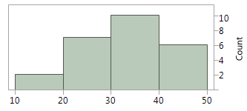
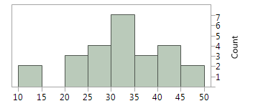
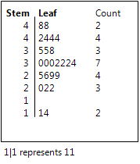
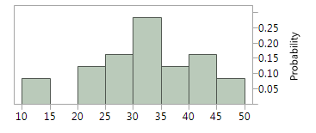
Problem #1 Solution
a) b)
c) d)

Slide 32
Problem #3
For the histogram that you made in Exercise 1a:
Is the distribution unimodal or multimodal?
Where is (are) the mode(s)?
Is the distribution symmetric?
Are there any outliers?

Slide 33
Problem #3 Solution
Unimodal
Around 35
Fairly symmetric
No outliers

Slide 34
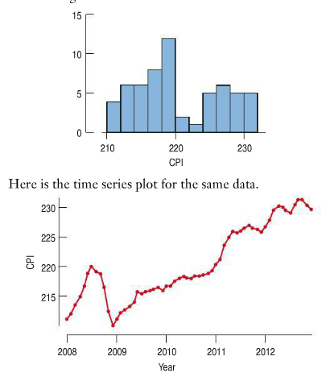
Problem #78
Here is a histogram and time series plot of the monthly CPI as reported by the Bureau of Labor Statistics from 2008 through 2013.
What features of the data can you see in the histogram that aren’t clear from the time series plot?
What features of the data can you see in the time series plot that aren’t clear in the histogram?
Which graphical display seems the more appropriate for these data? Explain.
Write a brief description of monthly CPI over this time period.

Slide 35
Problem #78 Solution
The frequency of the different CPI values
The trend of the values over time for the CPI
The time series plot
The monthly CPI increased until July 2008 and decreased slightly for August and September. Then decreased sharply during the months of October through December where it hit its all-time low. The CPI had a slow, but steady increase until about December 2010 when it started increasing sharply. CPI have increased overall, except for slight dips from Oct-Dec 2011 and March – July 2012.

